Slide 1

Computer Vision
From Fundamentals to Advanced Applications
A comprehensive guide covering image processing, deep learning, and state-of-the-art developments.

Slide 2
Part 1: Fundamentals
Understanding the building blocks of visual intelligence.

Slide 3
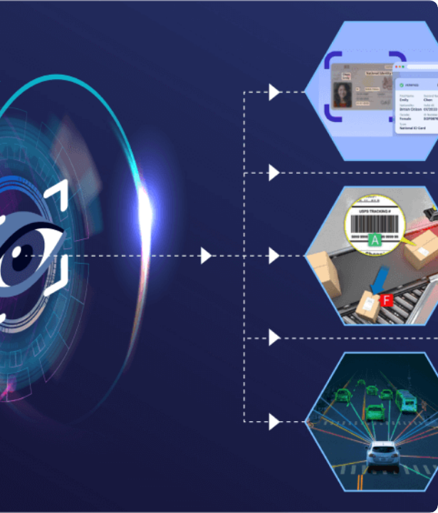
What is Computer Vision?
Computer Vision (CV) is a field of artificial intelligence that enables machines to interpret, understand, and derive meaningful information from visual data like images and videos.
It seeks to replicate the complexity of the human vision system using mathematical algorithms and neural networks, moving beyond simple capture to deep comprehension.

Slide 4

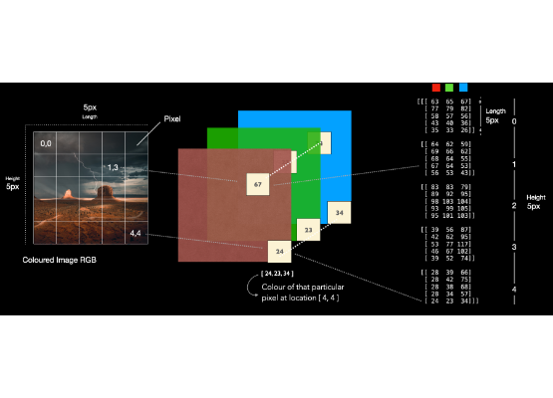
Images as Digital Data
Pixels and Matrices
To a computer, an image is just a grid of numerical values (pixels).
Grayscale images are represented by a 2D matrix where values denote intensity (0-255).
Color images are typically represented as 3D tensors, combining Red, Green, and Blue (RGB) channels.
All CV algorithms are essentially complex mathematical operations performed on these matrices.

Slide 5





Mathematical Foundations
Linear Algebra
Signal Processing
Calculus & Probability
The language of CV. Vectors, matrices, tensors, and operations like Singular Value Decomposition (SVD) are essential for transforming and manipulating image data spaces.
Techniques like the Fast Fourier Transform (FFT) allow analysis of images in the frequency domain, crucial for filtering, compression, and feature extraction.
Required for optimizing models (gradient descent in neural networks) and handling the inherent uncertainty in visual interpretations (Bayesian inference).

Slide 6
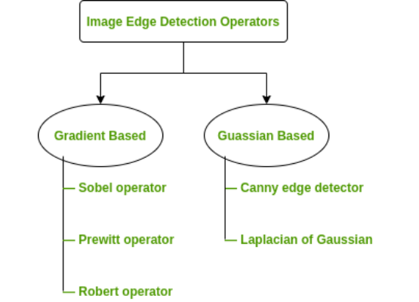
Traditional Image Processing
Before Deep Learning
Enhancement: Improving image quality (e.g., Histogram Equalization, Noise reduction via Median Filtering).
Feature Extraction: Identifying distinctive elements. Edge detection algorithms find object boundaries by detecting sharp changes in brightness.
Morphological Operations: Techniques like erosion and dilation used to process the structure of shapes within an image.

Slide 7

The Math Behind Filters: Convolution
Convolution is the core operation for applying filters (like edge detectors) and forms the basis of Convolutional Neural Networks (CNNs). It involves sliding a 'kernel' over the image matrix.
Where G is the output image, H is the kernel (filter), and F is the input image.

Slide 8
Part 2: The Deep Learning Era
How neural networks revolutionized visual perception.

Slide 9
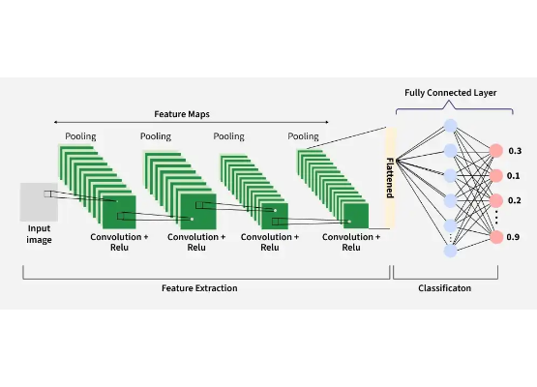
Convolutional Neural Networks (CNNs)
Learning Features Automatically
Unlike traditional CV where features (edges, corners) are hand-engineered, CNNs learn these features directly from data.
Convolutional Layers: Extract hierarchical features (simple edges early on, complex object parts later).
Pooling Layers: Reduce spatial dimensions, creating translation invariance and reducing computation.
Fully Connected Layers: Output the final prediction (e.g., class probabilities).

Slide 10
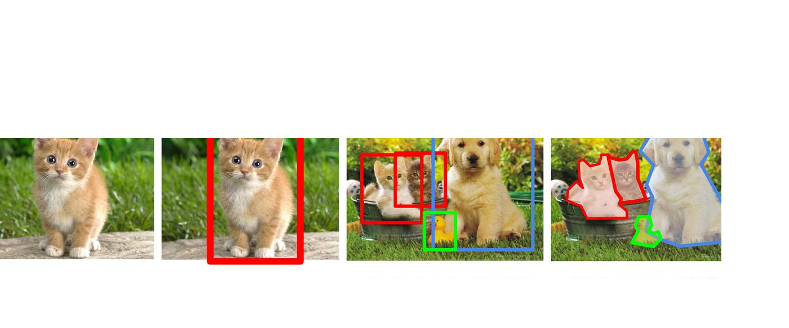

Core CV Tasks
Classification
Object Detection
Segmentation
Assigning a single label to the entire image. (e.g., "This is a cat").
Identifying multiple objects and locating them with bounding boxes.
Classifying every single pixel, creating precise boundaries (Semantic vs. Instance).

Slide 11



Beyond Standard CNNs
Vision Transformers (ViT)
Generative Adversarial Networks (GANs)
Applying the architecture behind ChatGPT to images. ViTs divide images into patches and use self-attention to model global relationships, often outperforming CNNs on large datasets.
Two networks (Generator and Discriminator) compete to create highly realistic synthetic images, useful for data augmentation and creative applications.

Slide 12
Part 3: Advanced Trends (2025-2026)
The cutting edge of visual intelligence.

Slide 13
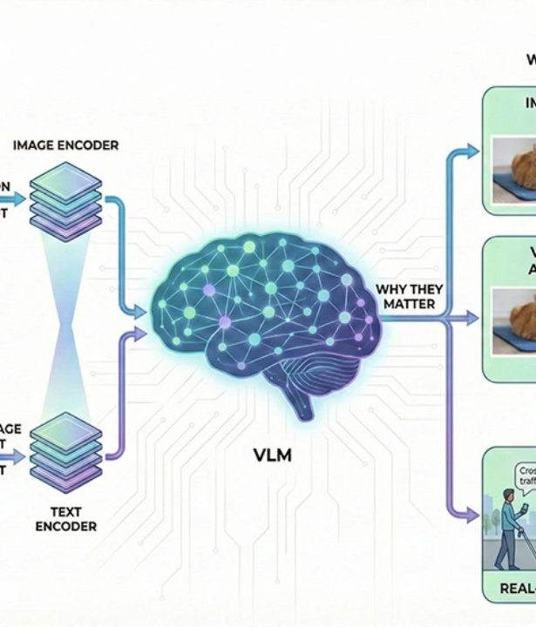
Multimodal AI & Vision-Language
Models are no longer limited to one type of data. Foundation models now jointly process visual data and text.
This enables natural language querying of images ("What part of this machine is broken?") and automated, context-aware report generation, bridging the gap between perception and reasoning.

Slide 14
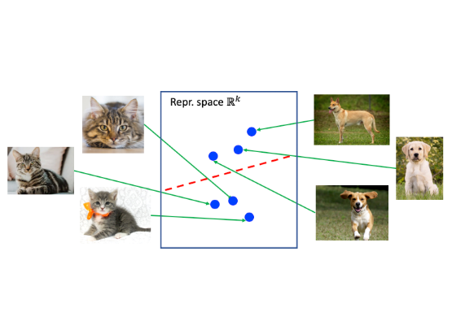
Self-Supervised Learning (SSL)
Reducing Labeling Bottlenecks
Historically, deep learning required massive, manually labeled datasets—a slow and expensive process.
SSL allows models to learn rich representations from vast amounts of unlabeled images by predicting hidden parts of the data.
These pre-trained models can then be fine-tuned on much smaller labeled datasets for specific tasks, drastically reducing development costs and time.

Slide 15

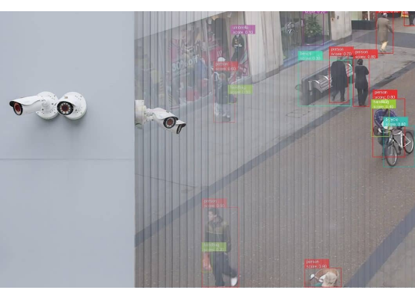
Edge Inference
Processing at the Source
By 2026, deploying CV models directly on edge devices (cameras, drones, factory sensors) is standard practice.
Benefits: Ultra-low latency for real-time decisions, reduced bandwidth costs (no need to send raw video to the cloud), and enhanced data privacy.
Enabled by dedicated Neural Processing Units (NPUs) and model optimization techniques like quantization and pruning.

Slide 16
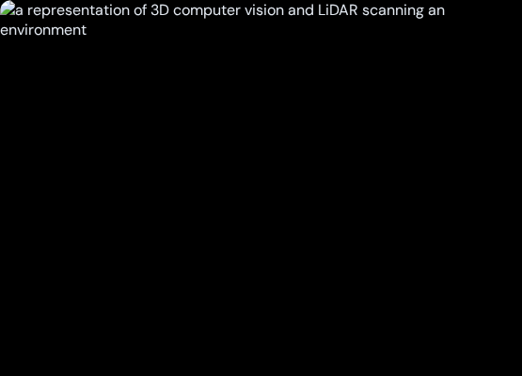
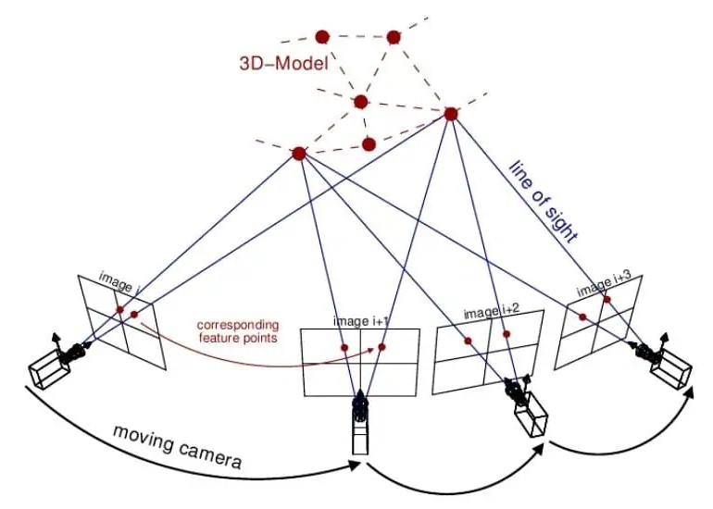
3D Perception & Spatial Vision
Beyond Flat Images
CV is moving from 2D plane analysis to full spatial understanding.
Integration with LiDAR and depth sensors provides precise 3D mapping.
Techniques like Gaussian Splatting and Neural Radiance Fields (NeRFs) allow for high-quality 3D reconstruction from standard 2D camera feeds.
Essential for robotics, advanced manufacturing, and emerging AR/VR spatial computing hardware.

Slide 17
Synthetic Training Data
76%
Solving the Data Scarcity Problem
Generative AI is increasingly used to produce synthetic digital images. This is crucial for training models on scenarios that are rare (edge cases in driving), dangerous, or heavily restricted by privacy regulations (medical imaging).
Share of Generative AI usage in CV Trends (2023 baseline)

Slide 18
Part 4: Industry Applications
Where theory meets the real world.

Slide 19
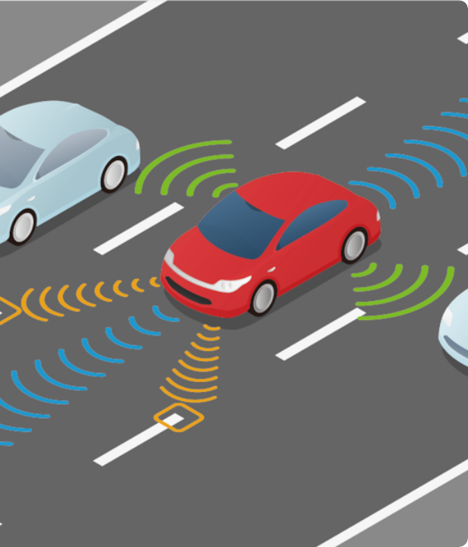
Mobility & Autonomous Vehicles
CV acts as the primary sensory system for autonomous driving and Advanced Driver Assistance Systems (ADAS).
Models perform real-time object detection (pedestrians, vehicles), lane tracking, and semantic segmentation to navigate complex urban environments reliably.

Slide 20
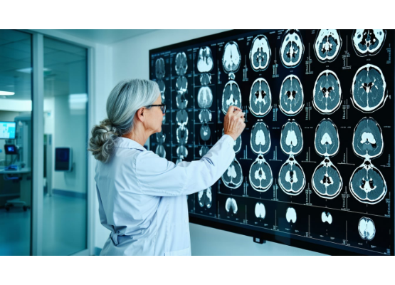
Healthcare & Medical Imaging
Augmenting Clinical Workflows
AI-enabled medical devices are expanding rapidly, particularly in radiology for automated diagnostics and scan analysis.
Pose estimation supports remote patient rehabilitation and movement analysis.
In biotech, automated cell counting and microscopy analysis accelerate drug discovery pipelines by processing millions of images.

Slide 21






Smart City Infrastructure
Traffic Management
Smart Parking
Urban Maintenance
Real-time analysis of traffic flow, vehicle counts, and violation detection for adaptive signal control.
Camera systems detecting available spaces, feeding data to guidance apps to reduce urban congestion.
Automated detection of potholes, graffiti, and infrastructure damage for proactive repair scheduling.

Slide 22
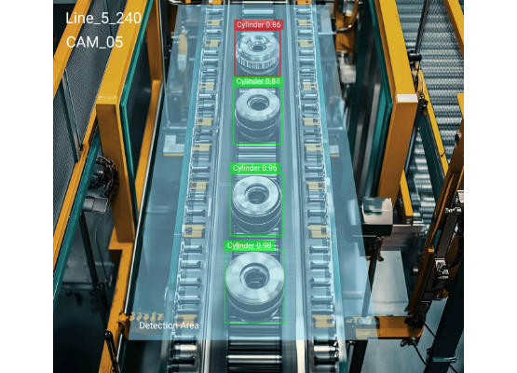
Manufacturing & Industry 4.0
Quality Assurance at Scale
Automated Visual Inspection (AVI) systems detect micro-defects on production lines with higher accuracy and speed than human operators.
Enables predictive maintenance by visually monitoring equipment wear and tear.
Vision-guided robotics are heavily utilized in warehouse logistics for automated picking and sorting.

Slide 23
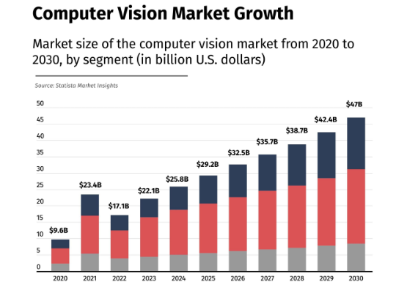
Market Projection
Explosive Growth
The CV market is expanding rapidly as the technology transitions from experimental projects to core product capabilities.
For example, the utilization of computer vision specifically in autonomous vehicles is projected to reach massive scale with high compound annual growth rates (CAGR) approaching 40% through 2026.

Slide 24
Part 5: Strategy & Deployment
Taking CV from the lab to production.

Slide 25



Building a Data Strategy
Targeted Labeling
Synthetic Data
Unlabeled Value
Focus expensive manual labeling efforts on the core, unique tasks where foundation models fall short.
Utilize generative tools to create synthetic data to fill gaps and represent rare edge cases.
Employ Self-Supervised Learning (SSL) to extract baseline representations from large volumes of raw, unlabeled video.

Slide 26
API vs. Custom Development
When to Build Custom:
Objects or environmental conditions are highly unique to the organization.
A Hybrid Approach:
Required accuracy exceeds what standard API models deliver.
Many teams start with APIs for rapid prototyping and routine tasks, using the resulting labeled data to later train specialized custom models for high-value edge cases.
Data privacy requirements prohibit sending images to third-party cloud services.
Processing volumes are so high that cloud API costs exceed edge infrastructure costs.

Slide 27

Regulatory & Ethical Considerations
Navigating Compliance
EU AI Act: Establishes binding requirements, prohibiting real-time biometric surveillance in public spaces in most cases.
Regulated Sectors: Medical imaging and autonomous driving face strict auditing, documentation, and human-oversight requirements.
Privacy Engineering: Techniques like federated learning and on-device anonymization (blurring faces before storage) are critical for compliance.

Slide 28

Lab Session 1
Building a Baseline Image Classifier

Slide 29
Lab Session 2
Implementing Edge Detection & Basic Object Tracking

Slide 30
Q&A

